Slide 1
PostgreSQL & SQLite Performance Analysis
Yilu Zhou
Yutong Xie
https://github.com/ACS-Xie-Zhou/ACS_Project/tree/main/Final_Project

Slide 2


PostgreSQL
SQLite
A free and open-source relational database management system emphasizing extensibility and SQL compliance
Based on a client-server model
Transactions with Atomicity, Consistency, Isolation, Durability (ACID) to guarantee data validity despite errors and power failures.
Embedded database
ACID-compliant and implements most of the SQL standard, generally following PostgreSQL syntax.
A popular choice as embedded database software for local/client storage in application software such as web browsers.

Slide 3
SQLite vs PostgreSQL
 | SQLite | PostgreSQL
Library | <600 KB | Much larger than SQLite
Architecture | File based Embedded | Client/Server
Data Size Limitation | <140 TB | Unlimited
Security and Authentication | No authentication system (3rd party extension exists) | A lot of security features
Transactional Consistency | ACID | Strong ACID

Slide 4

Testing Environment
Database Benchmark Tool | TPC-H v2.18.0
Testing Device | Raspberry Pi 4B with 2GB RAM Broadcom BCM2711, Quad core Cortex-A72 (ARM v8) 64-bit SoC @ 1.5GHz. 2GB LPDDR4-3200 SDRAM. Sandisk 32GB U1, A1, class10 TF card SDSQUNC-032G-ZN3MN. Read: 120MB/s Write: 10MB/s. Heat sink and fan to prevent thermal throttling. Raspberry Pi OS with desktop 32-bit. Kernel version: 5.10.
Version | SQLite3: 3.35.5 PostgreSQL: 13.2.

Slide 5
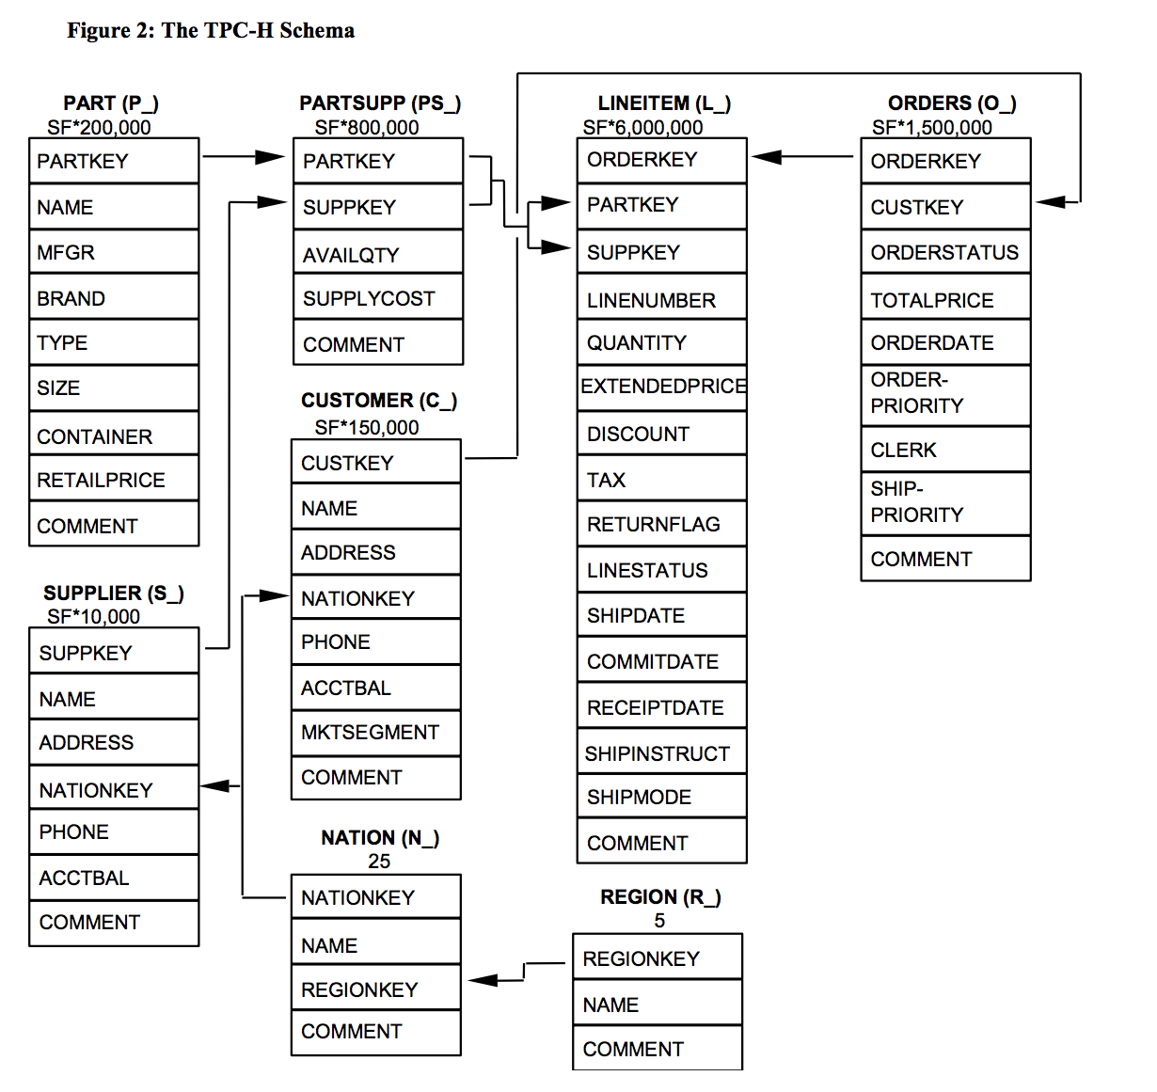
TPC-H
The TPC Benchmark™H (TPC-H) is a decision support benchmark. It consists of a suite of business oriented ad-hoc queries and concurrent data modifications. The queries and the data populating the database have been chosen to have broad industry-wide relevance while maintaining a sufficient degree of ease of implementation. This benchmark illustrates decision support systems that
• Examine large volumes of data;
• Execute queries with a high degree of complexity;
• Give answers to critical business questions.
Table Name | Number of Tuples
region | 5
nation | 25
partsupp | 800,000
customer | 150,000
lineitem | 6,001,215
orders | 1,500,000
part | 200,000
supplier | 10,000

Slide 6
Testing Approach
There are 22 queries provided by TPC-H applied to test the performance of the databases. Due to several differences in querying between PostgreSQL and SQLite, two different versions of queries are generated by TPC-H for compatibility. The queries can be found in the PGSQL_Queries and SQLITE_Queries in the github repository. A general definitions of the queries are listed in the repository. The running time of each SQL query are recorded.

Slide 7
Testing Results
Query Number | Type | PostgreSQL Time(s) | SQLite Time(s)
1 | Pricing Summary Report | 0.21 | 37.551
2 | Minimum Cost Supplier | 41.816 | 1.487
3 | Shipping Priority | 42.969 | 11.024
4 | Order Priority Checking | 23.594 | 1.213
5 | Local Supplier Volume | 22.624 | 6.351
6 | Forecasting Revenue Change | 17.366 | 5.234
7 | Volume Shipping | 15.578 | 22.046
8 | National Market Share | 5.188 | 35.84
9 | Product Type Profit Measure | 27.861 | 94.626
10 | Returned Item Reporting | 10.791 | 5.337
11 | Important Stock Identification | 4.346 | 3.109
Notes:
The running time of each queries for the two databases are shown in the table.

Slide 8
Testing Results
Query Number | Type | PostgreSQL Time(s) | SQLite Time(s)
12 | Shipping Modes and Order Priority | 2.811 | 5.461
13 | Customer Distribution | 5.651 | 78.3999
14 | Promotion Effect | 27.018 | 7.241
15 | Top Supplier | 8.102 | 5.486
16 | Parts/Supplier Relationship | 13.233 | 2.008
17 | Small-Quantity-Order Revenue | N/A | N/A
18 | Large Volume Customer | 14.61 | 6.101
19 | Discounted Revenue | 2.249 | 7.265
20 | Potential Part Promotion | N/A | N/A
21 | Supplier Who Kept Orders Waiting | 4.761 | 30.657
22 | Global Sales Opportunity | 1.629 | N/A
 | Average | 15.30410526 | 19.28615263
 | Standard Deviation | 12.45593892 | 25.74306548
Notes:
The running time of each queries for the two databases are shown in the table.
We can see that postgre has a lower average time and standard deviation

Slide 9
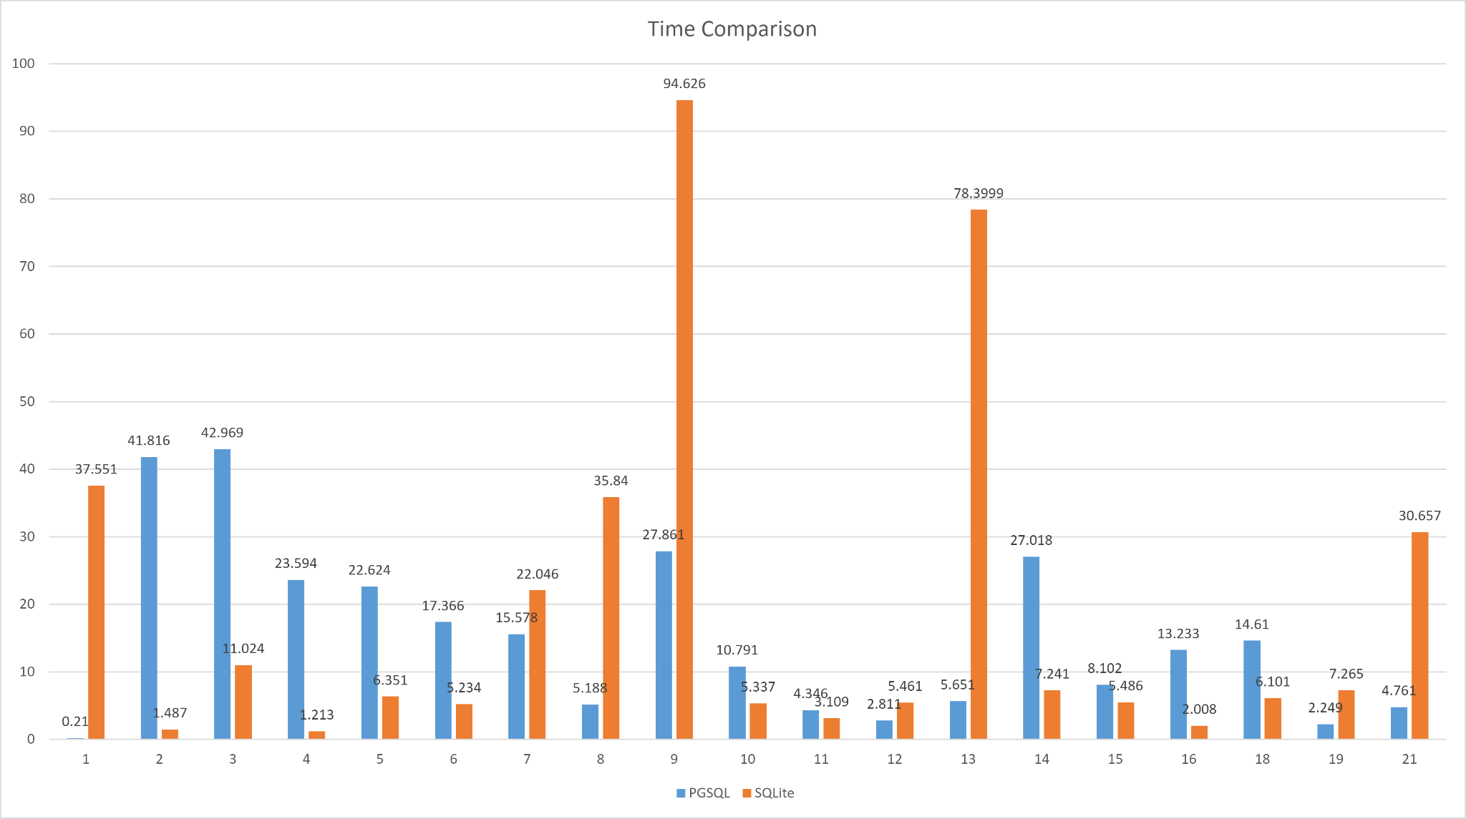
Notes:
We can see that the performances for different queries are quite different. It did not result in a significant better performance for one database.

Slide 10
Testing Result Analysis
From the testing result, we can find that on average, PostgreSQL spends 4 seconds less than that of SQLite3. Also, the standard deviation is much smaller for PostgreSQL than for SQLite3. This indicates that PostgreSQL has a better overall performance compared to SQLite3. This can be caused by the slow disk read/write performance. For Raspberry Pi, the micro-sd cards are used as the storage devices. The best micro-sd cards on the market can provide 100MB/s read and write speed. This is equivalent to the speed of HDD drives. Modern data centers can use better storage devices, such as NVMe drives and RAID to improve the speed of the storage devices. As a result, when using better storage devices, the performance for both database can be improved. In addition, when comparing results of different queries, we found that PostgreSQL has better performance than SQLite when the query consists of more joining operation. For SQL query without complex joinning operation, SQLite normally has better performance over PostgreSQL.
Notes:
From the testing result, PostgreSQL has lower average running time and lower deviation, so for this testing environment, PostgreSQL wins. For queries, we notice that PostgreSQL has better performance than SQLite for queries joining a lot of tables. While for queries without complex joining operations, SQLite has better overall performance than PostgreSQL. Besides from the performance of databases, we think the testing platform, especially the storage device, also have significant influence on the testing result. With better storage device, the performance different of the two databases might be more significant.

Slide 11
Conclusion
PostgreSQL forks a new process for each time client connection. As a result, for simple read-heavy operations, PostgreSQL is worse in performance than other RDMBSs. However, PostgreSQL has been full ACID-compliant since 2001 and it implements multi-version currency control to ensure that data remains consistent.
SQLite3 uses a serverless approach. Any process that accesses the database reads from and writes to the database disk file directly. As a result, there is no need to configure a server process like PostgreSQL. The whole database is stored as a separate file and can be located anywhere in the system. It can also be shared to other systems seamlessly. SQLite implements serializable transactions that are ACID, even if the transaction is interrupted by a program crash, an operating system crash, or a power failure to the computer. However, although the concurrency performance is not evaluated in this test, it is predictable that SQLite has worth high concurrency performance comparing to PostgreSQL due to its serial handling of writes operations.
To summarize, SQLite is a good choice for small apps that do not require expansion, while PostgreSQL is suitable for applications requiring better high concurrency performance and reliability.
Notes:
In conclusion, we believe that the expense of multiple processing might lower the performance of PostgreSQL for simple queries. But on the other hand, PostgreSQL is a strong ACID database, so it has better concurrent performance and security than SQLite. In addition, SQLite also has ACID implementation, but it applies a serial handling of writing operation, which becomes a bottleneck of its performance. SQLite also seems slower when the queries getting more complex and has a lot of joining operations. Overall, SQLite is good for software that requires an embedded database without a heavy load, while PostgreSQL is suitable for more complex application.

Slide 12
Reference
https://www.sqlite.org/index.html
https://www.postgresql.org/
http://www.tpc.org/tpc_documents_current_versions/pdf/tpc-h_v2.18.0.pdf

